Slide 1
Insights on San Francisco City Employee Salary Data
Team Pandas

Slide 2
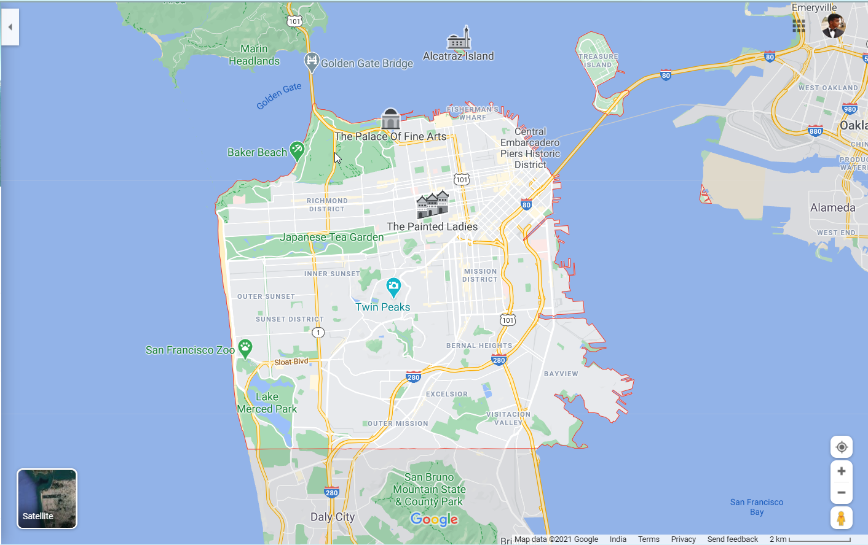
San Francisco Map

Slide 3
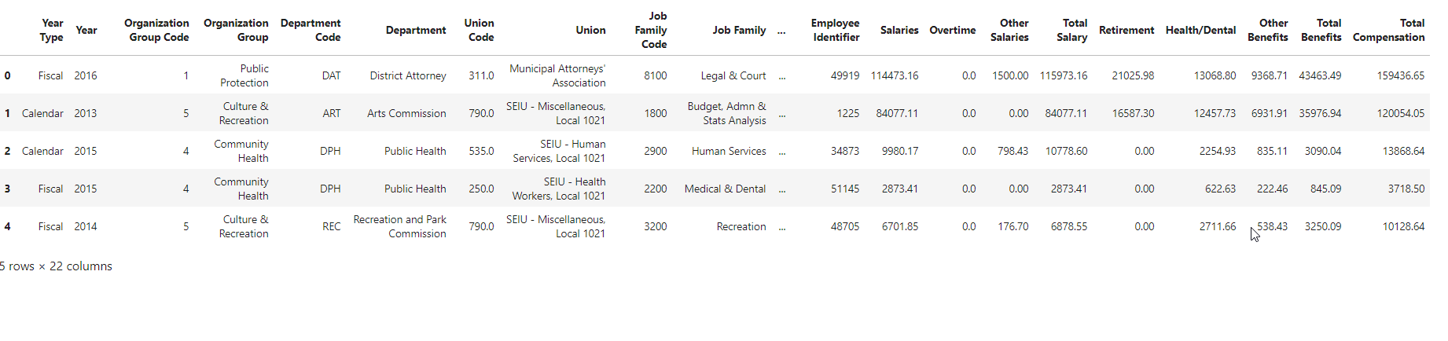
Exploring the Data

Slide 4
General Structure of Data
Organization
Departments
Jobs
Employee

Slide 5


Negative Values on Salaries
Why?
No of Rows in Total DataFrame :
290391
Non Negative Rows in Dataframe :
42 Missing Union Codes
No Duplicate Rows
Only 0.004 Rows has negative values:

Slide 6
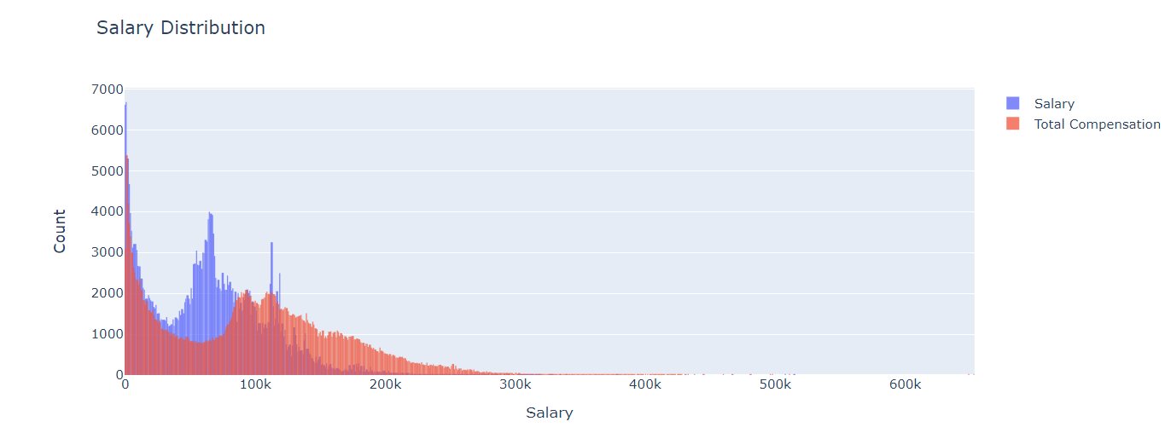
Wealth Distribution across Employees
Data Tells Story:
https://qz.com/711854/the-inequality-happening-now-in-san-francisco-will-impact-america-for-generations-to-come/

Slide 7
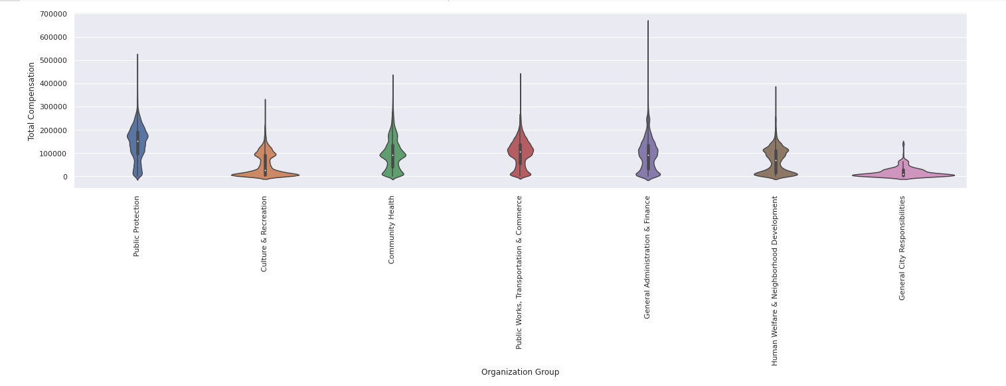
Why Violin Plot?
Salary Distribution Among Organizations
Colab

Slide 8
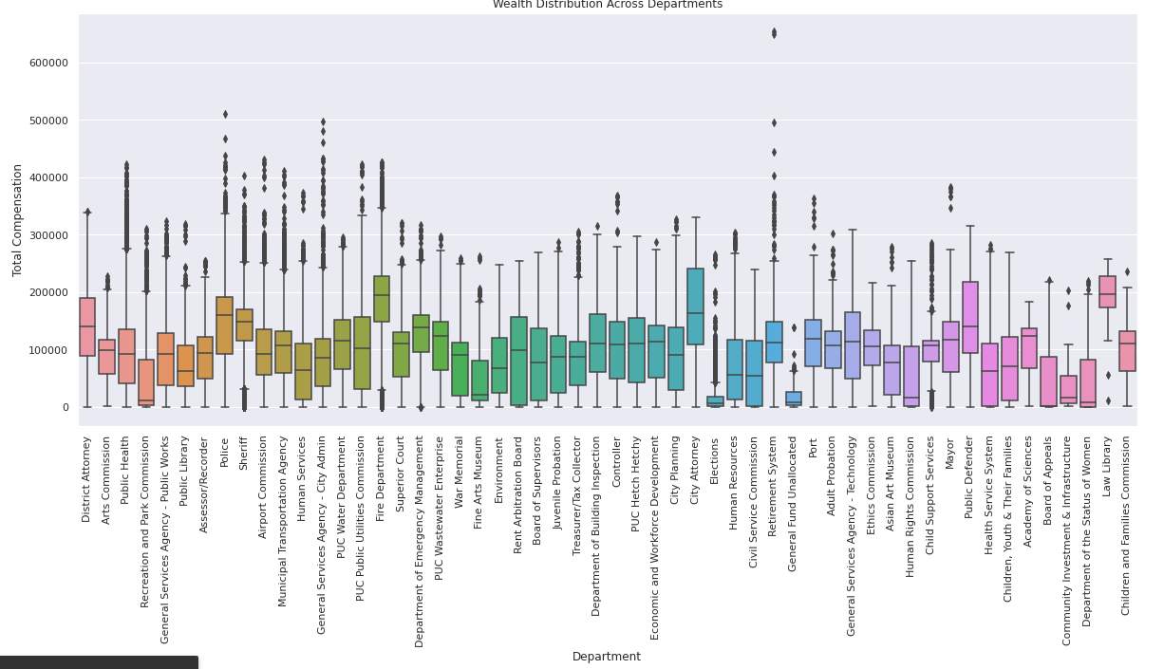
Wealth Distribution Across Departments
colab

Slide 9
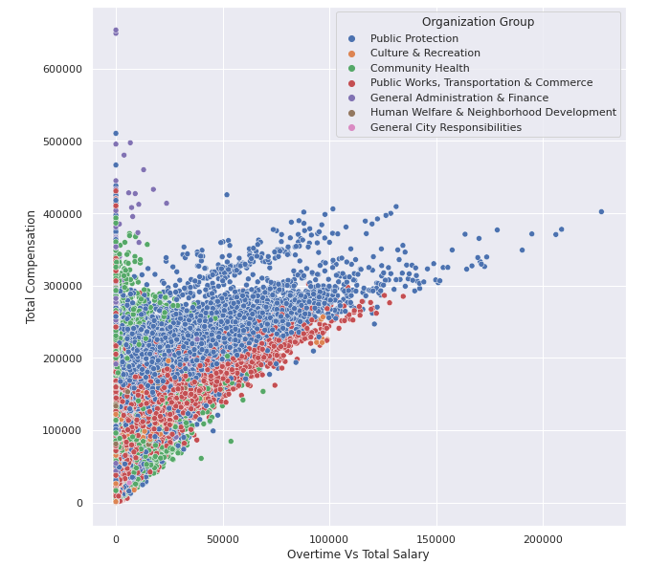
Does Overtime Leads to More Salary?

Slide 10
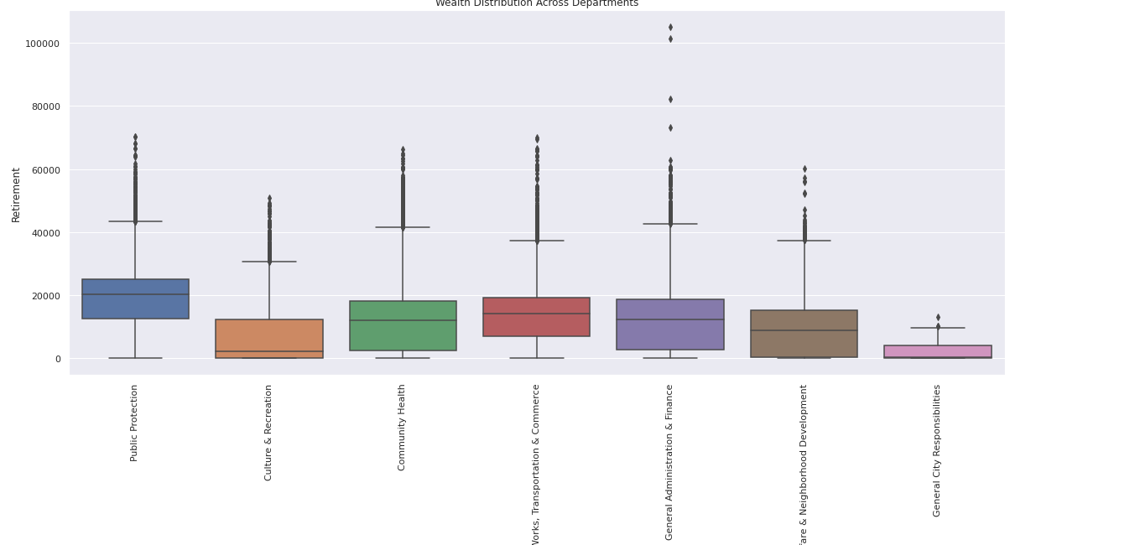
Retirement Plan

Slide 11
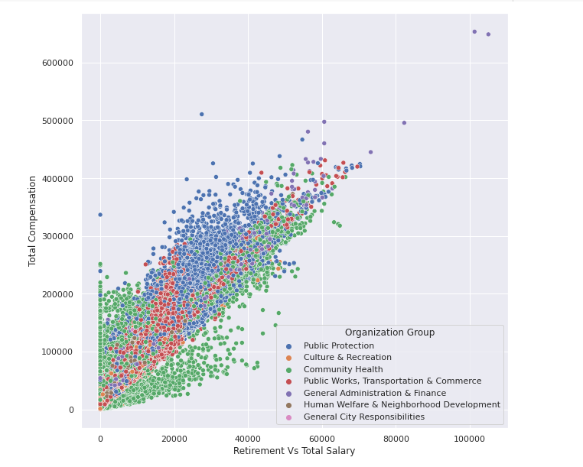
Retirement Correlation with the The Salary

Slide 12
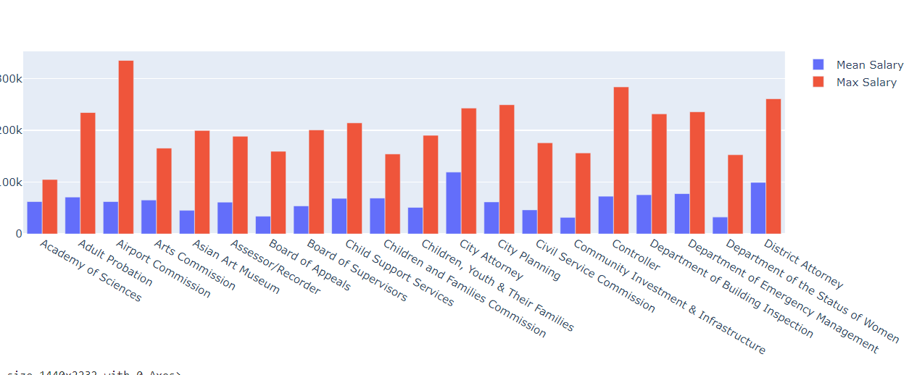
Inequality Among Max Salary and Mean Salary of Department

Slide 13
Using the Power of Groupy to get some Insights
Jupyter
https://sfist.com/2016/04/25/sf_now_has_highest_per_capita_prope/
https://www.nytimes.com/2016/04/25/us/san-francisco-torn-as-some-see-street-behavior-worsen.html

Slide 14
Main Aim Was to Not Draw Many plots but to signify How Data can tell the Real Life Story by itself with little Manipulation

Slide 15
Thank You
“In God we trust, all others must bring data.” - W. E. Deming

